Slide 1
LO: Commas for lists

Slide 2
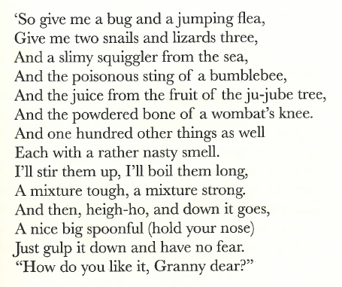
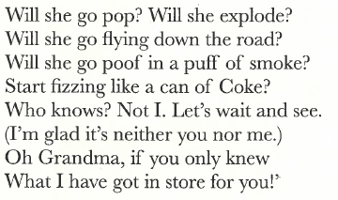
Extract from “The Marvelous Plan”
Read this poem out loud.
What punctuation can you see?

Slide 3
There were a lot of commas, why were there so many?
We use commas for lists, it makes sentences flow better.
For example, “At the farm Peter saw geese and cows and pigs and an old cart.”
The sentence does not sound right; there are too many ands.
It should be written like this:” At the farm Peter saw geese, cows, pigs and an old cart.”

Slide 4
Please rewrite these sentences; take out the extra “ands” and put in commas.
The packet contained red and blue and green and yellow felt tips.
At the top of the league were Birmingham and Manchester United and Crewe and Aston Villa and Walsall Town.
Violins and recorders and drums and guitars were all set out in the music room.
Britain is made up of England and Scotland and Wales and Northern Ireland.
The tube was full of purple and green and yellow and red Smarties.

Slide 5
Your task is to create a list poem similar to the on in Chapter 2.
Here is an example:
A magnificent medicine I shall make!
So give me a dung beetle, a rusty pan and some cake,
Give me the fur off the tail of a cat,
And the leg of frog, ten worms and the wing of a bat,
…..
Thing I would like you to note:
Commas for lists
Capital Letter at the start of each line
Rhyming words
The next slide has some rhyming words you may find useful and a format you may wish to use.

Slide 6
